Slide 1
“Explore Spain by Train”
@spanish.gap.year

Slide 2
Program Director
Arantxa López
Get in Touch
Phone/Text: +353 852329296
info@spanishgapyear.com
@spanish.gap.year
Notes:
My name is, Director of SGY and I’m here to present our program. I am a Spanish teacher and hold a Degree in Education, a Diploma in Bilingualism and I’m currently completing an MA in Language Acquisition. I am also ELE and TEFL certified.

Slide 3
Program Overview:
Ready for the trip?
3 Bases
3 Long Trips
7 Weekend Trips
Experiential Learning
12 weeks around Spain - by train
@spanish.gap.year
Notes:
Spain by Train is a 12-week journey around different regions of Spain. This is an experiential learning program with three main bases, in which we spend an average of 18 days, and we do several trips between bases.

Slide 4
Program Overview:
3 bases: Basque Country, Salamanca & Granada
3 long trips: Camino de Santiago, Madrid & Barcelona
Weekend trips: Bilbao, Seville & Valencia
Cross-border visits: Porto in Portugal & Biarritz in France
It’s going to be an amazing trip!
@spanish.gap.year
Notes:
Our journey starts in Madrid, where you fly into. We then move directly to our first base, in the Basque Country in the North, by the shores of the Atlantic Ocean. Our second base is in Salamanca and our third is in Granada, in the south of Spain. So you really get to live a great variety of regions. We also do in-between-base trips through the Camino de Santiago, to Madrid and Barcelona. These trips last 10 days. Finally, we have weekend trips to beautiful cities like… A very exciting addition are our cross-border visits to Porto, in Portugal, while we are in Salamanca, and to Biarritz in France, while we are in the Basque Country.

Slide 5
A memorable experience
Spanish Gap Year
All our travelling is done by train, which is not only the most sustainable form of travel but also very comfortable and clean
Travel
Accommodation
Discover Spain by train
Residential and homestay while in the bases
Boutique hostels during trips
Luggage free!
@spanish.gap.year
Notes:
All our travelling is done by train, which is not only the most sustainable form of travel but also very comfortable and clean. We won’t have to carry our luggage from place to place often, as we will have time to properly settle in each place we visit. Accommodation varies depending on where we are: it is private residential in base one, homestay in bases 2 and 3 and boutique hostel accommodation during trips.

Slide 6
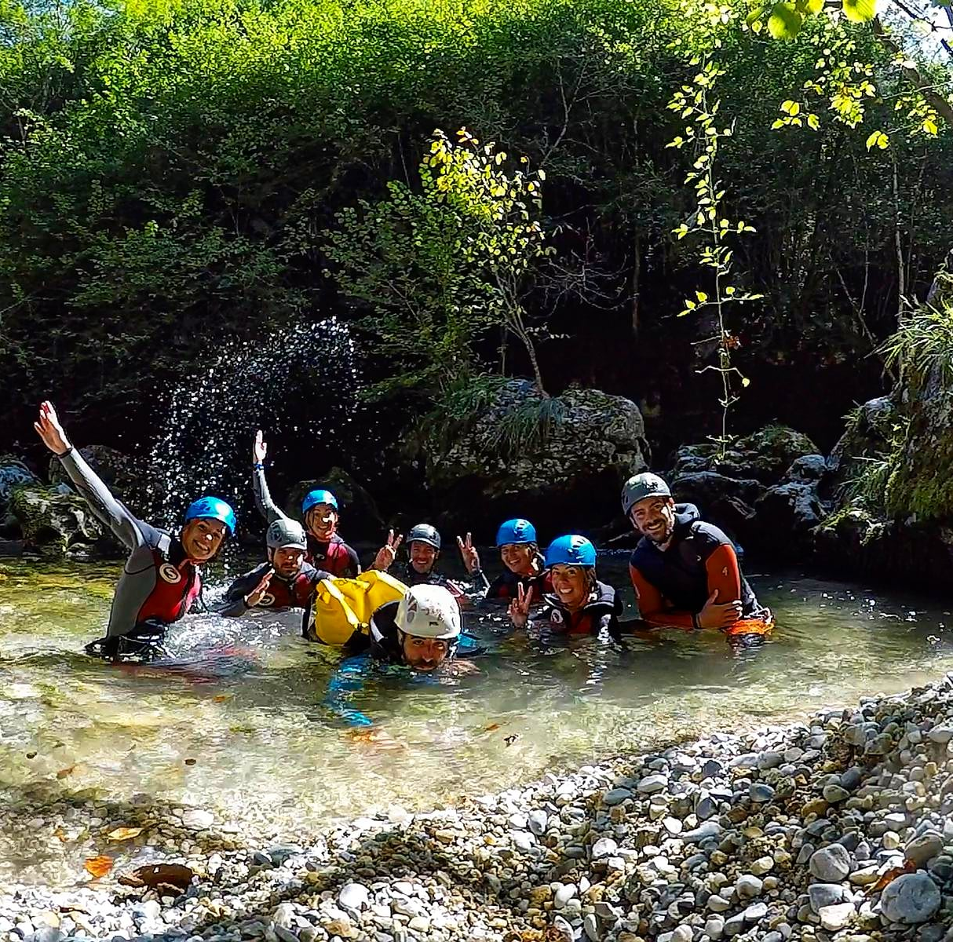
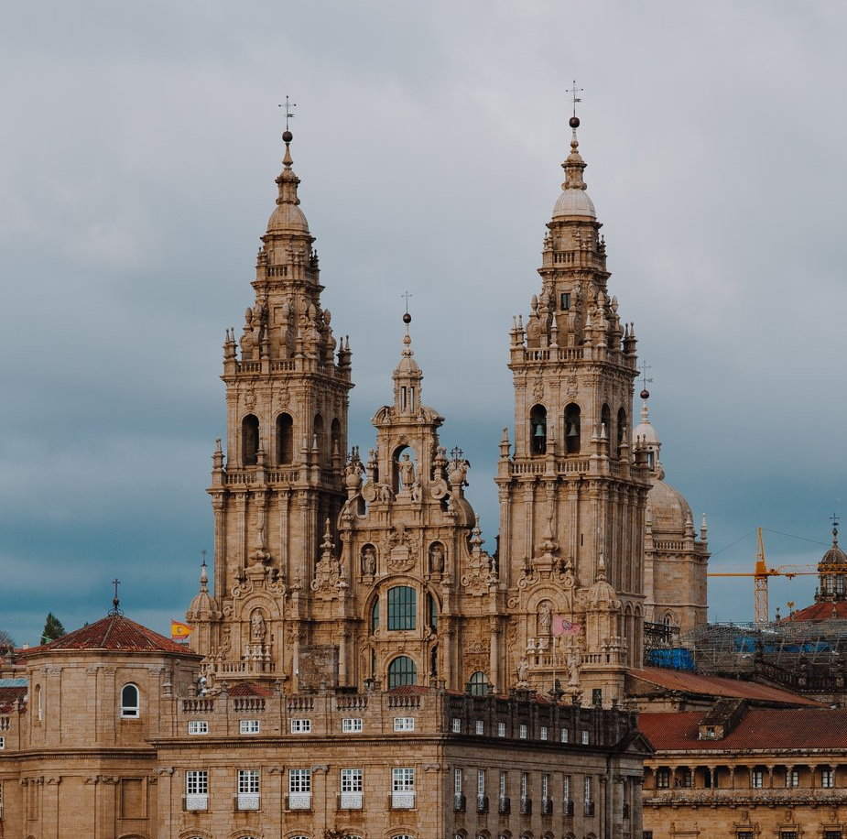
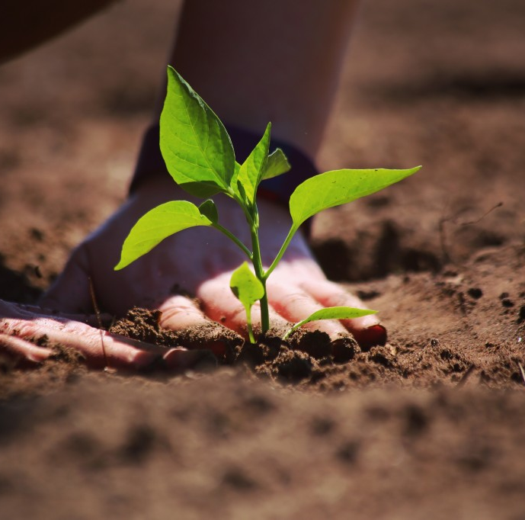
A memorable experience
Adventure: Surf, kayak, trekking
Culture: Food, history, architecture, art
Volunteering: Sustainable farming
Social entrepreneurship & leadership
Spanish Gap Year
Apply Now
ACTIVITIES:
@spanish.gap.year
Notes:
We have a wide range of activities: from adventure sports like surfing, kayaking or hiking, to cultural workshops and volunteering community projects.

Slide 7
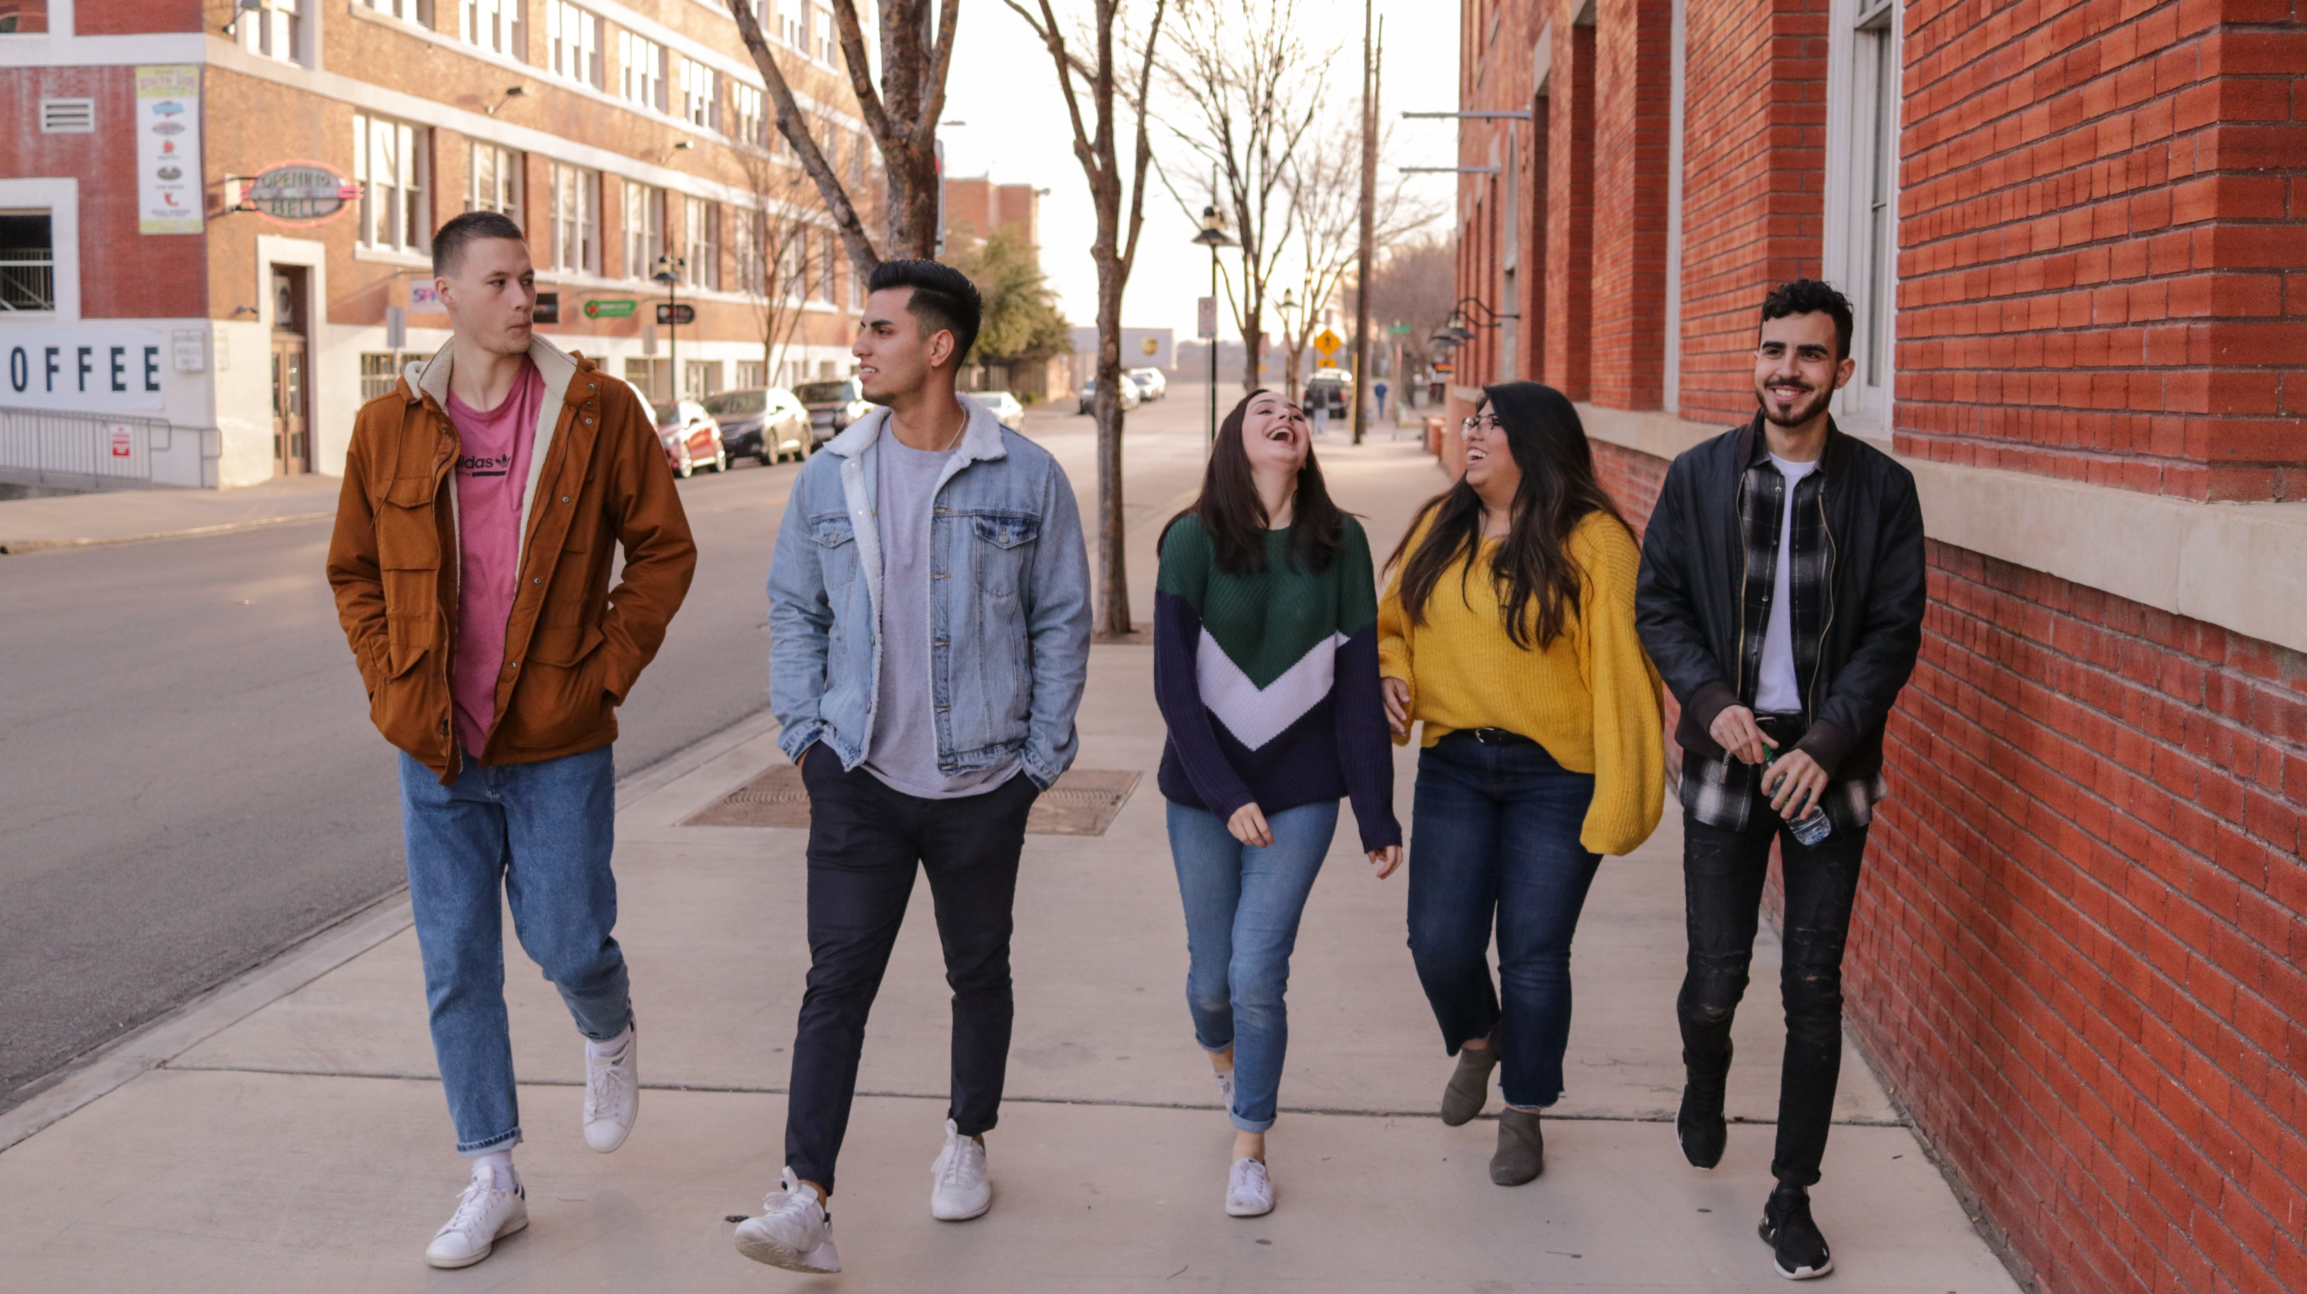
Spanish Gap Year
The trip you’ll never forget!
Core Values
Multiculturality & multilingualism
Mutual respect & inclusivity
Sustainability & ethical living
Resilience, teamwork & cooperation
Personal responsibility, accountability & growth
«Ultimately, a concept of true, global leadership.»
@spanish.gap.year
Notes:
Now, before we speak about content, we would like to talk to you about our values. You need to know that values are paramount to us. In this regard, we strive to convey & instill values that will stay with you throughout your whole life and that will always be useful in your personal development. In line with this, our core values are… Ultimately, our concept is that of, what we consider to be, true global leadership. And this concept underpins our whole program and all the contents that are part of it.

Slide 8
Spanish Gap Year
Curriculum: Concept
Open, participative, travelling classroom
Structured program with plenty of down time
Spanish language: project-based experiential learning
@spanish.gap.year
Notes:
The framework of the program is designed to acquire both language and content through an enjoyable immersion experience and far from traditional classroom methods.

Slide 9
Spanish Gap Year
Curriculum Contents
12 learning modules:
Content: Spanish, Art, Theatre, Film, Food, Music, Dance, History, Geography, Sport, Nature, Science & Sustainability
Outcomes:
Personal development & wellbeing
Global leadership
Don’t miss this experience
@spanish.gap.year

Slide 10
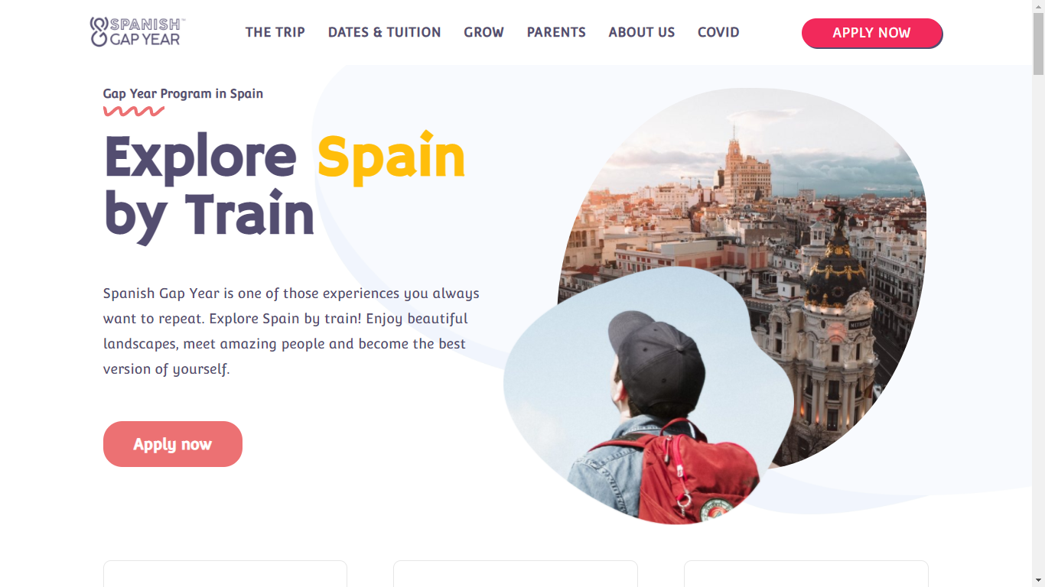
Let’s talk!
Continue the Conversation with Spanish Gap Year @
www.spanishgapyear.com
Phone / Text: +353 852329296
info@spanishgapyear.com
insta: @spanish.gap.year
Arantxa López – Program Director
@spanish.gap.year
Notes:
We would love to hear from you and will be delighted to set up a virtual meeting with you to answer all your questions.

